Slide 1


NeuroBin
Smart solutions for sustainable living.

Slide 2

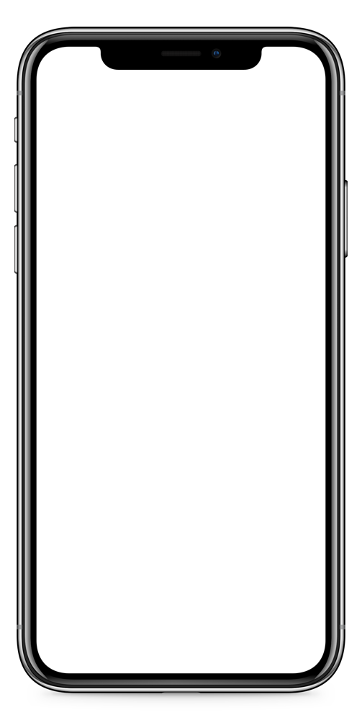

Introduction
Transforming Waste into a Greener Tomorrow.
Our intelligent waste management app empowers you to identify, categorize, and dispose of waste responsibly. It helps you contribute effortlessly to a cleaner environment with waste detection, navigation of nearest disposal bins and garbage truck schedules.

Slide 3
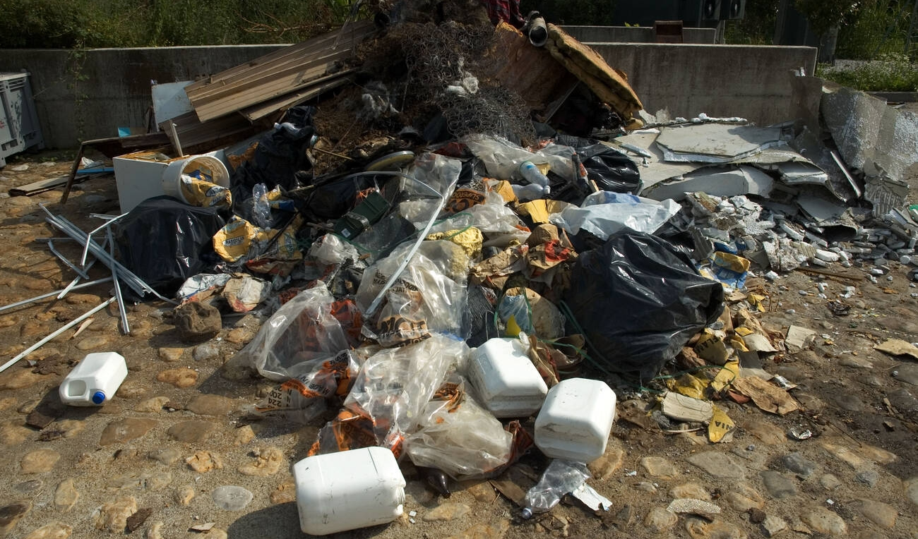
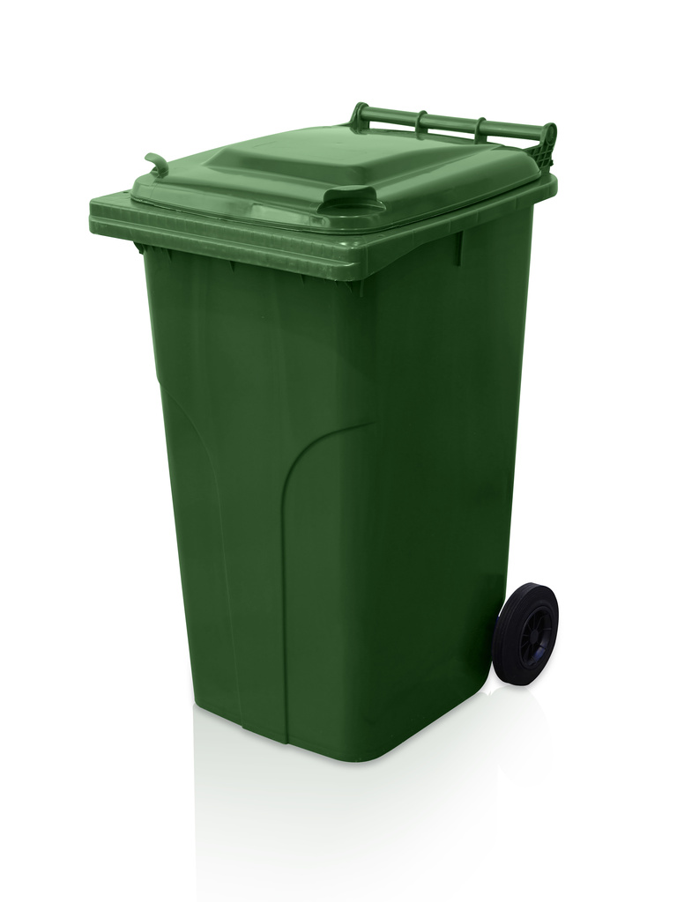
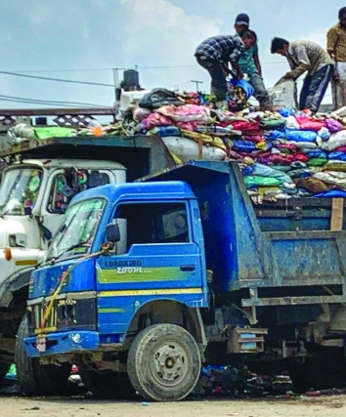
Problem Statment
Lack of Public Awareness
Lack of Information About Location of Bins
Lack of Information About Schedule of Garbage Trucks

Slide 4
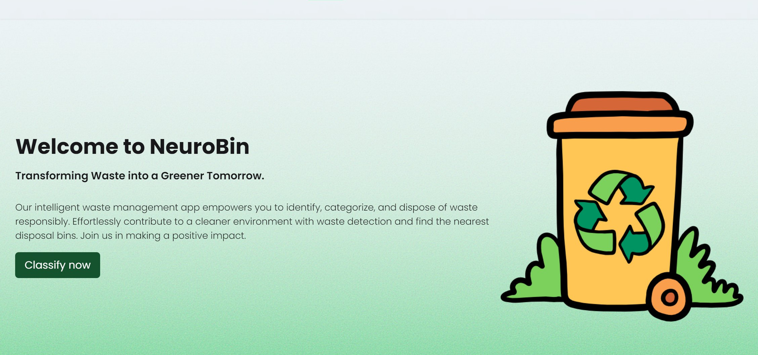
The Solution

Slide 5
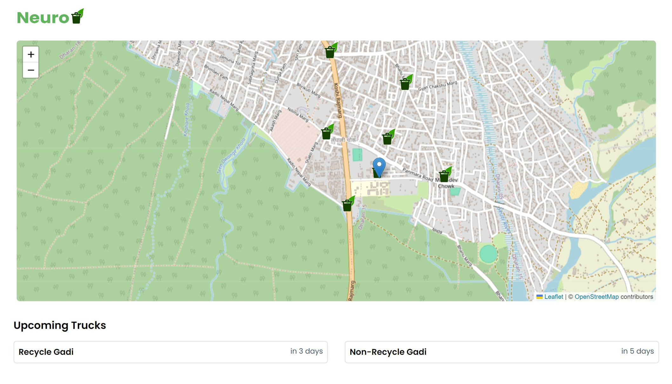

Proposed Solution
Digital Awareness
Encouraging individuals to segregate bio-degradable and non-biodegradable waste for responsible disposal.
Live Bin Location
Providing users with a real-time location of bins.
Garbage Truck Schedules
Proper scheduling of upcoming garbage trucks.

Slide 6


Rewards
To keep users invested in our app we have a features called rewards. For every waste disposed, users get points which could be exchanged for real rewards.

Slide 7

Conclusion
NeuroBin aligns seamlessly with the theme of "Green Technology: Software for Sustainable Development" by deploying advance image detection to empower individuals in segregating wastes.
By implementing technology for sustainable living, NeuroBin contributes to a cleaner environment, aligning with the overarching goal of promoting green practices and responsible waste management for a more sustainable future.

